Slide 1
Paying for Higher Education
First name Last name | Date
Notes:
Notes:
[Greet the audience and introduce yourself.]
Today, I’d like to share with you some ideas about how to spot and avoid scams while you’re paying for education.
NOTE TO PRESENTERS:
You don’t have to cover all the issues in this PPT.
We recommend you pull out only the things you want to cover, considering the audience and length of time given for the presentation.
If you want to use all of the slides, we estimate the full presentation will run approximately 15 minutes.
Also, you don’t have to use the notes verbatim. We offer them as a foundation.
The information was pulled from existing vetted materials.

Slide 2
Who The FTC Is and What It Does
Enforcement
Consumer and Business Education
Building Partnerships and Coalitions
Notes:
First, let me tell you a little bit about the FTC. As the nation’s consumer protection agency, the FTC works to stop fraud, deception, and unfair business practices. This is done in several different ways.
Through enforcement, the FTC does investigations, sues companies and people that break the law, and tries to get money back to people whenever possible.
Many of those cases are based on the reports the FTC gets from people just like you, who talk about the scams and dishonest practices they see – even if they don’t lose money.
Through education and outreach, the FTC tells people about their rights and businesses about their responsibilities
In print, online, and in person (or virtually), the FTC shares how to spot and avoid scams, how to report them, and how talking about a scam – with anyone – helps protect not just yourself but also your network.
Finally, the FTC can’t do it alone. By working with groups from libraries and community advocates to state and federal agencies, the FTC tries to amplify the message and reach a broader audience.

Slide 3
Spot and Avoid Scams While Paying for Higher Education
FAFSA Scams
FSA ID Scams
Scholarship Scams
Student Loan Repayment Scams
Student Loan Forgiveness Scams
Notes:
After high school, many of us find that we need more education or training to get the jobs or careers we want. We may need to take classes at a community college, get a degree from a university or trade school, or complete a training certification. The reality is higher education can be expensive and most of us can’t afford to pay for it outright. But finding other ways to pay for school can feel like jumping through hoops, too. Scammers know this so they pretend to help you through the process, but they’re really after your money and personal information.
Today, we’ll talk about how to recognize scams related to paying for higher education. We’ll cover how to keep your personal information (and your money) out of the wrong hands while applying for financial aid and how to avoid debt relief scams when you start repaying those student loans. Let’s get started.

Slide 4
Free Application for Federal Student Aid (FAFSA)
Apply at StudentAid.gov (or FAFSA.gov)
It’s always free to fill out
Complete it yourself (or with family)
Notes:
The Free Application for Federal Student Aid (FAFSA) is usually the first stop for financial aid like federal grants and student loans. Scammers try to make you think the application is harder than it is so they can insist on helping you but really: There’s nothing anyone else can do for you that you can’t do for yourself, for free. Here’s what to know to avoid FAFSA scams:
Apply at StudentAid.gov or FAFSA.gov [emphasize the .gov]. And nowhere else. If anyone tells you to fill out the FAFSA but sends you to a website that ends in .com, .org, .co, or anything other than .gov, it’s a scam.
It’s in the name but it’s worth emphasizing here — The FAFSA is always free! Anybody who says you need to pay to submit it or says they’ll help you fill it out for an upfront fee (which is illegal, by the way) is a scammer.
Complete the FAFSA yourself (or with family). There are lots of reasons to never let someone else file your FAFSA, which we’ll talk about on the next slide. But the most important reason is because they’ll get access to your log-in information and all your sensitive personal information. Just play it safe — and fill it out yourself.

Slide 5
FSA ID Scams
Don’t share your FSA ID.
Scammers use it to take over
your account.
Notes:
Your FSA ID is your Federal Student Aid account username and password. Scammers know it’s the key to getting into your FAFSA and a wealth of sensitive information there about you and your family. In your FAFSA, a scammer could find things like your family’s full names, dates of birth, and income information.
Your FSA ID is also linked to your Social Security number, which means that anything that happens in the account is your responsibility. That’s one reason that parents have to have their own FSA ID – they can’t share one with their student. So, if you remember one thing today, it’s this: Asking for your FSA ID is a clear sign of a scam — Don’t share it.
Some scammers say they’ll use your FSA ID to file your FAFSA in a way that maximizes the funds available to you. But they might use illegal means to get you aid you don’t qualify for (like lying about your income). And any fraudulent information they enter will come at a hefty cost to you. You could be charged with a felony for FAFSA fraud and fined up to $20,000 or sentenced for up to five years in jail, or both.
Someone with your FSA ID could log into your account and make changes without your permission. They might do it while you’re applying (giving them access to personal information) or down the road when you’re paying off your student loans, when they’d have access to real money.
What’s that one thing to remember? [PAUSE FOR ANSWER] Never share your FSA ID with anyone. Knowing this will help protect yourself and the people you care about.

Slide 6
Scholarship Scams
Scam #1: “The scholarship is guaranteed or your money back.”
Scam #2: “I just need your credit card or bank account number to hold this scholarship.”
Scam #3: “We'll do all the work. You just pay a processing fee.
Notes:
Scholarships are essentially free money, since you typically don’t have to pay back. You might find scholarship opportunities through a high school guidance counselor or the school you want to attend. But, as you search, you might also find scams. Here’s how scholarship scams often work:
Someone guarantees you a scholarship. That’s a scam. There simply are no guarantees when it comes to scholarships.
You’re asked to enter checking account or credit card information to “confirm eligibility” or hold a scholarship. If you have to pay anything to apply or receive a scholarship (like processing costs, redemption fees, or any other upfront cost), it’s not free. It’s a scam.
Some honest companies do sell lists of scholarships. And some charge you upfront to run your information through their database to then give you a list of awards that you might be eligible for. Obviously, you can decide whether those services are worth the price to you. The difference is an honest company will never guarantee or promise scholarships or grants.

Slide 7
Student Loan Repayment Scams
Time to repay your loans?
Start with StudentAid.gov/Repay
Notes:
Scams don’t stop once you get your degree, finish your training program, or leave school. When it’s time to start repaying your student loans, scammers will be there. Often, they’re looking for ways to direct you away from StudentAid.gov. They’ll also try to steer you away from your loan servicer, which is the company that manages billing and other services related to your student loans.
If someone contacts you about repaying your loans, pay attention to who they say they are, what they offer you, if they pressure you, and what they ask you to do. The FTC covers this and lot more at ftc.gov/studentloans, but here are a few ways to avoiding loan repayment scams:
Know that only scammers offer “guaranteed” access to special repayment or debt reduction plans. Those are scams.
Don’t let scammers pressure you to pay subscription or processing fees, sign third-party authorization forms, or share personal information like your FSA ID. Pressure usually means a scam and you’ll find all the help you need (for free) at StudentAid.gov/Repay.
Check out StudentAid.gov/Consolidation before consolidating any of your loans. Some dishonest companies might say you’ll save money if you consolidate your federal loans with their private company. What they won’t mention is that some consolidations, especially with private lenders, can disqualify you for some or all federal loan repayment and forgiveness programs.

Slide 8
Student Loan Forgiveness Scams
Forgiveness is always free
StudentAid.gov/Forgiveness
Notes:
Have you heard about federal student loan forgiveness programs? So have scammers. They follow the headlines and try and confuse you about what’s real and what’s not. Here’s what’s real: it’s always free to apply for federal student loan forgiveness programs, and you can read all about them at StudentAid.gov/Forgiveness.
If a scammer contacts you about fake loan forgiveness, they might share details about you or your loans, or say they’re affiliated with the Department of Education. The idea is, of course, to get you to trust them. But none of this means they’re legit. Trust what’s at StudentAid.gov. And hang up if someone says any these things:
“Sign up right away or you’ll miss qualifying for exclusive repayment plans and loan consolidation programs.” Pressure like this usually means it’s a scam. Take your time and check it out first.
“Just pay a small upfront fee and we’ll help you skip the line/eliminate your student debt/sign you up for an exclusive quick loan forgiveness program.” Upfront fees are illegal and no one can help you skip the line or get your loans forgiven. Those are all scams.

Slide 9
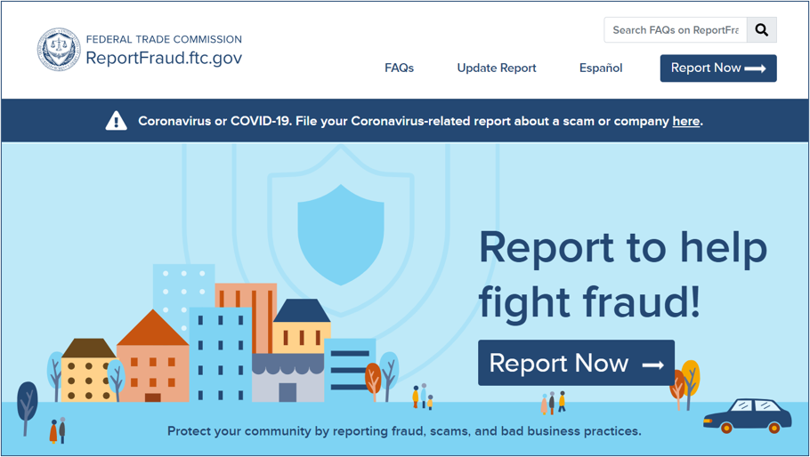
Report Fraud to the FTC
English:
ReportFraud.ftc.gov
Spanish:
ReporteFraude.ftc.gov
Notes:
Notes:
This is what the site looks like when you report a scam.
The FTC uses reports to investigate and bring law enforcement cases. Reports also help the FTC know what scams to alert people about, so they can protect themselves, their friends, and family.
When you follow a few short steps at ReportFraud.ftc.gov, your report is instantly available to more than 3,000 federal, state, and local law enforcers across the country. And, once you tell the FTC what happened, you’ll get advice on what to do to recover and how to guard against fraud in the future.

Slide 10
Get and Share FREE Resources
Learn about education: ftc.gov/education
Learn about paying for education: consumerfinance.gov/payingforcollege
Keep in touch: ftc.gov/consumeralerts
Notes:
I mentioned at the start that partners are a powerful way to spread the word. Now that you’re part of our network, we hope you’ll share what you’ve learned with people you know. Here are some other places to learn more about paying for education and other consumer protection topics. And an important way to keep in touch.
ftc.gov/education: Advice on education and training, as well as student loans, car maintenance, and repossession.
consumerfinance.gov/payingforcollege: The Consumer Financial Protection Bureau’s Paying For College page offers free resources to help you navigate the ins and outs of financial aid and repaying loans.
ftc.gov/consumeralerts: How to keep up with the latest FTC actions, as well as the top frauds and scams we’re seeing. Sign up, get alerts, and keep in touch!
It’s worth repeating that all of the FTC’s consumer resources are also available in Spanish online and in print. I hope you’ll share these resources in your communities. Thanks so much for your time and attention.

Slide 11
Questions
Notes:
Notes:
Are there any questions?

Slide 12
Thank you
Notes:
Notes:
Thanks again for your time today.

