Slide 1
Shopping and Saving
First name Last name | Date
Notes:
Notes:
[Greet the audience and introduce yourself.]
Today, we’ll be talking about shopping and how to avoid the scams that come up.
NOTE TO PRESENTERS:
You don’t have to cover all the issues in this PPT.
We recommend you pull out only the things you want to cover, considering the audience and length of time given for the presentation.
If you want to use all of the slides, we estimate the full presentation will run approximately 15 minutes.
Also, you don’t have to use the notes verbatim. We offer them as a foundation.
The information was pulled from existing vetted materials.

Slide 2
Who the FTC Is and What it Does
Enforcement
Consumer and Business Education
Building Partnerships and Coalitions
Notes:
Notes:
First, let me tell you a little bit about the FTC. As the nation’s consumer protection agency, the FTC works to stop fraud, deception, and unfair business practices. This is done in several different ways.
Through enforcement, the FTC does investigations, sues companies and people that break the law, and tries to get money back to people whenever possible.
Many of those cases are based on the reports the FTC gets from people just like you, who talk about the scams and dishonest practices they see – even if they don’t lose money.
Through education and outreach, the FTC tells people about their rights and businesses about their responsibilities
In print, online, and in person (or virtually), the FTC shares how to spot and avoid scams, how to report them, and how talking about a scam – with anyone – helps protect not just yourself but also your network.
Finally, the FTC can’t do it alone. By working with groups from libraries and community advocates to state and federal agencies, the FTC tries to amplify the message and reach a broader audience.

Slide 3
What to Know Before You Shop
Spot fake sites
Look up delivery, return, and refund policies
Use safer payment methods (when possible)
Recognize what payment plans are
Learn what to do if you accidentally pay a scammer
Report fraud to the FTC
Notes:
Notes:
Now: let’s talk about shopping and how to avoid the scams that come up.
Shopping can be essential to our daily lives, from things we buy often — say, groceries, to things we hope to only buy rarely, like new home appliances. And everything in between. Whatever we’re shopping for, it can get expensive fast.
So today, I’d like to talk with you about some ways to keep our shopping budget out of the hands of scammers. We’ll discuss how to spot scams, protect your payments, and the steps to take if you spot a scam. So, let’s get started.

Slide 4
Spot Fake Sites
Check out unfamiliar online stores
Read reviews to see what others are saying
Notes:
Notes:
Let’s say you’re just shopping around online and run across unusually low prices. Should you jump on it quickly before the deal goes away? [PRESENTER pauses for discussion, if time/if you want]
I’m saying no, and here’s why: one sign of a scam is a surprisingly low price, especially on things in short supply. Think about masks early in the pandemic. Or the “it” toy any December. Scammers set up fake websites or profiles on social media. They use images of the product and brand logos to make you think you’re buying stuff from the official website. If you buy, at best, you’ll get a knock-off…but at worst, you’ll get nothing.
So before you order from an online store you don’t know, check them out. Search online for the site’s name, plus words like “review,” “complaint,” or “scam” to see what other people are saying. And it’s a good idea to check out a few sources before you hand over your money.

Slide 5
Look Up Delivery, Return, and Refund Policies
Confirm delivery information with seller
Notes:
Notes:
So now you’ve checked out the site, and you’ve checked what people say about the site and the stuff you want to buy. But before you buy, find out about shipping and delivery. When will you get the goods?
Honest businesses want happy, returning customers, so they honor their delivery windows. When you buy online, sellers have to ship your order in the time they promised. If they didn’t give a specific time, they have to deliver within 30 days. If they don’t, tell the seller as soon as possible. If they didn’t ship your item within the timeframe they promised, the law says you can cancel your order for a full refund.

Slide 6
Look Up Delivery, Return, and Refund Policies
Check return policies
Know your rights
Notes:
Notes:
While you’re at it, also check the seller’s refund and return policy. This is especially important if you’re buying something on sale or clearance, where the rules might be stricter.
If you think you qualify for a return but the seller won’t give you your money back, you have some options:
Start by filing a complaint, however the site takes them
Visit websites for groups like Call for Action, Consumer Action, or the Better Business Bureau to file a complaint or start a review
Share your experience on social media. Companies monitor social media and might reply if they see you’re dissatisfied with their response to your complaint.

Slide 7
Use Safer Payment Methods (When Possible)
Use a credit card if you can
Keep records
Dispute charges when necessary
Know that only scammers tell you to pay by gift card, wire transfer, or cryptocurrency
Notes:
Notes:
OK, so you’re ready to buy. If possible, use a credit card instead of a debit card. Credit cards give you the most protections against fraud, including being able to quickly dispute charges if there are problems with your purchase. To help you get your money back from the seller or file a dispute with your credit card company, keep information about what you bought, when you bought it, and how much you paid. Always save your receipts or confirmation emails. Hold onto them until you get what you ordered and know you won’t return things.
If you discover that you paid a scammer, the product was a fake, or you never got it, your credit card payment can be charged back quickly once you report it to your card.
Here’s a warning sign for any kind of scam: only scammers will demand that you pay by gift card, by wiring money through companies like Western Union or MoneyGram, or with cryptocurrency. Scammers want you to pay in these ways because they’re nearly impossible to trace or reverse.

Slide 8
Recognize What Payment Plans Are
Read the terms and conditions
Understand the risks and benefits
Notes:
Notes:
But what if you don’t have the cash or credit to pay in full right away? Whether you’re shopping online or in a store, the business might give you ways to pay over time — maybe through rent-to-own, layaway, or “buy now, pay later” plans. With some of these plans, you could end up paying a lot more in the long run. So there’s a decision to make if you’re considering paying over time: do I need this thing so badly — right now — that I’m willing to pay far more, over time, than the actual price?
Even if that answer is yes, before you choose one of these plans, find out the terms and conditions — what you have to pay and when, any penalties for late payment, and what to do if there’s a problem.

Slide 9
Learn What to Do if You Accidentally Pay a Scammer
Figure out if it’s a problem or a scam
Contact the company or bank
Ask for your money back
Report fraud
Notes:
Notes:
Sometimes, there’s a problem with something you ordered. Maybe it’s not the color you were expecting, or it arrived damaged. If you have a similar problem when you shop, try to work it out directly with the seller. But, if the product is fake, not even close to what you ordered, or you never get it, you might have been scammed.
If you fall into the scam category, act quickly. If you paid a scammer, contact the company you used to pay them — so, that could be your bank, the credit card or gift card company, the wire transfer service, the money transfer app, or the cryptocurrency company. Tell them it was a fraudulent charge and ask them to reverse the transaction so you can try to get your money back. It might not work, but it’s always worth trying. Then, take a few minutes to report the scam at ReportFraud.ftc.gov. After you report it, you’ll get advice on what to do next to recover and protect yourself.

Slide 10
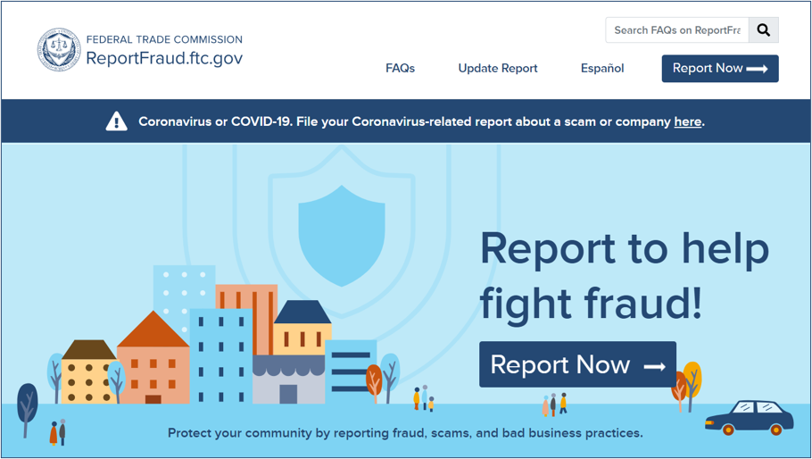
Report Fraud to the FTC
English:
ReportFraud.ftc.gov
Spanish:
ReporteFraude.ftc.gov
Notes:
Notes:
This is what the site looks like when you report a scam.
The FTC uses reports to investigate and bring law enforcement cases. Reports also help the FTC know what scams to alert people about, so they can protect themselves, their friends, and family.
When you follow a few short steps at ReportFraud.ftc.gov, your report is instantly available to more than 3,000 federal, state, and local law enforcers across the country. And, once you tell the FTC what happened, you’ll get advice on what to do to recover and how to guard against fraud in the future.

Slide 11
Get and Share FREE Resources
Learn about online shopping: ftc.gov/onlineshopping
Learn about scams: consumer.ftc.gov
Keep in touch: ftc.gov/consumeralerts
Get print materials: ftc.gov/bulkorder
Notes:
Notes:
As I’ve said, partnerships with community members and organizations are an important way to get the word out, and to hear about what’s happening in different communities. Now you’re part of that network, and we hope you’ll share what you learned with people you know.
Here’re some other places to learn more about job scams, money-making schemes, and other consumer protection topics, as well as an important way to keep in touch.
ftc.gov/onlineshopping – has even more advice about everything we’ve talked about today.
consumer.ftc.gov – has articles, videos, and graphics about a whole range of consumer protection topics.
ftc.gov/consumeralerts ­– is the best way to keep up with the latest from the FTC, including the top scams it sees. Sign up to get alerts and keep in touch!
ftc.gov/bulkorder – is where you can order printed materials, for free, in English and Spanish. The FTC will ship them to you for free. We hope you’ll order early and often.
Whether you get FTC materials online or in print, we hope you’ll share them with friends and family in your communities. Thanks so much for your time and attention.

Slide 12
Questions
Notes:
Notes:
Are there any questions?

Slide 13
Thank you
Notes:
SCRIPT:
Thanks again for your time today.

