Slide 1
Taking Control of Your Credit Report
First name Last name | Date
Notes:
NOTE TO PRESENTERS:
You can use this presentation as is or customize it for a particular audience.
You don’t have to use all the notes/script under each slide or use them verbatim. It’s there as background.
If you want to use all the slides, we estimate the full presentation will run approximately 15 minutes.
The information in this PPT is from existing FTC materials.

Slide 2
Who We Are and What We Do
Protecting Consumers
Enforcement
Consumer and business education
Building partnerships and coalitions
Notes:
First, let me tell you a little bit about the FTC. As the nation’s consumer protection agency, the FTC works to stop fraud, deception, and unfair business practices. This is done in several different ways.
Through enforcement, the FTC does investigations, sues companies and people that break the law, and tries to get money back to people whenever possible.
Many of those cases are based on the reports the FTC gets from people just like you, who talk about the scams and dishonest practices they see – even if they don’t lose money.
Through education and outreach, the FTC tells people about their rights and businesses about their responsibilities
In print, online, and in person (or virtually), the FTC shares how to spot and avoid scams, how to report them, and how talking about a scam – with anyone – helps protect not just yourself but also your network.
Finally, the FTC can’t do it alone. By working with groups from libraries and community advocates to state and federal agencies, the FTC tries to amplify the message and reach a broader audience.

Slide 3
Your Credit Report
Why it matters
Fixing mistakes
Spotting credit repair scammers
Taking control
Notes:
Today, we’re talking about your credit report and why it’s important. We’ll talk about how to get your report for free, review it, and fix any mistakes you find. We’ll touch on the difference between a credit report and a credit score. We’ll also talk about scammers, including the ones who promise to quickly boost your credit, but instead just take your money. We’ll wind up with ways to take control of your credit. I’d like to leave time for your questions too, so let’s get started.

Slide 4
Why Your Credit Matters
Your credit history can make a big difference when you try to
apply for a loan or credit card
buy or lease a car
rent an apartment
get a job
buy insurance
Notes:
When people talk about your credit, they usually mean your credit history. Your credit history describes how you use money: things like how many credit cards and loans you have, and whether you pay your bills on time.
Credit bureaus — like Equifax, Experian, and TransUnion — collect this information into your credit report. Businesses pay the credit bureaus to use this information to help decide if they want to do business with you — and on what terms. For example, lenders use it to decide what interest rate to charge you. So, your credit affects not just WHETHER you’ll get a loan, but what you’ll pay for it. Others who might look at your credit history include landlords, insurance companies, and potential employers.
If businesses see that you always pay your bills on time and never take on more debt than you can pay back, they’ll usually feel more confident about working with you. That’s why your credit history can make a big difference when you do things like try to get a loan, a car, housing, a job, insurance, and more.

Slide 5
Get Your FREE Credit Reports
Visit AnnualCreditReport.com, or
Call 1-877-322-8228
Notes:
Your credit report summarizes your credit history. Because it affects so many things in your life, it’s important to find out what it says and make sure that it’s correct. If there are mistakes, you’ll want to fix them. To start with, get your free credit report. By law, you can get a free copy of your credit report every year from each of the three major credit bureaus — Equifax, Experian, and TransUnion. To get your report, visit AnnualCreditReport.com or call 1-877-322-8228. AnnualCreditReport.com is the only site where the report is REALLY free, and where it’s your legal right to get your report. Other sites may charge you money. There may also be fake sites set up to steal your personal information. At AnnualCreditReport.com, you’ll fill out an online form with your name, birth date, and Social Security number. They’ll ask you some questions to make sure it’s you, and then you’ll get your credit report.

Slide 6
What’s a Credit Score?
Based on info in your credit report
Lots of scoring systems
There is no free annual score
Notes:
A quick note about credit scores. Your credit score is based on the information in your credit report. Sometimes businesses use your credit score to quickly predict how likely you are to repay a loan and pay your bills on time. Different credit bureaus use different models to calculate it, so your score can vary. But it’s usually a number somewhere between 300 and 850.
It might be interesting to know your score, but when it comes to reviewing your credit history and fixing mistakes or problems, you’re better off focusing on your credit report. Also, unlike your credit report, there’s no free annual credit score required by law. Some companies you do business with might give you free credit scores. Others may give you a free credit score if you sign up for their paid credit monitoring service.
Before you pay any money to get your credit score, be sure you know what you’re paying for. And ask yourself if you even need to see it. Only you can answer that.

Slide 7
Review Your Credit Reports
Personal information
Account information
Recent credit inquiries
Notes:
Once you have your credit report, check to make sure the information is accurate, complete, and up to date.
Here, you’re looking for possible mistakes. Do they have the right name and address listed? Make sure they have the right information about how you pay your bills, like if a company didn’t credit you for a payment you made. You’re also looking for signs of possible identity theft. For example, if you see accounts on your report that you never opened, or credit inquiries by companies where you never applied for credit.
Go through each section of your report and note any mistakes you find.
One thing to remember: Sometimes one credit bureau will have slightly different information from the others. So, make sure you review your credit reports at all three nationwide credit bureaus, especially if you’re about to apply for a loan for a big purchase like a house or a car, or if you’re about to buy insurance or apply for a job. Otherwise, consider how often you feel like you need to check all three.

Slide 8
Fix Mistakes on Your Credit Report
Dispute mistakes with
the credit bureau reporting the error, and
the business that supplied the information
Visit ftc.gov/credit for credit bureau contact info, sample letters, and more!
Notes:
What if you spot a mistake on your credit report? Maybe it’s a mistake in your name or address, or an unpaid debt that’s been on your credit report for more than seven years. That, by the way, is the limit for most negative information on your credit report. If you find mistakes on your report, you can take steps to fix them.
Both the credit bureau and the company that supplied the incorrect information have to correct information that’s wrong or incomplete in your report. And they have to do it for free. To correct mistakes in your report, contact the credit bureau and the business that reported the inaccurate information. Tell them you want to dispute that information in your report.
For the credit bureaus, dispute mistakes with each credit bureau that has the mistake. Do that by mail, phone, or online. Explain to them what you think is wrong. If you need to, send copies of documents that support your dispute, but keep your original documents. No matter how you file your dispute, the credit bureau has 30 days to investigate it, and has to give you the results in writing.
To learn more about how to dispute errors on your credit report, visit ftc.gov/credit. There, you’ll find credit bureau contact information, sample letters, and more.

Slide 9
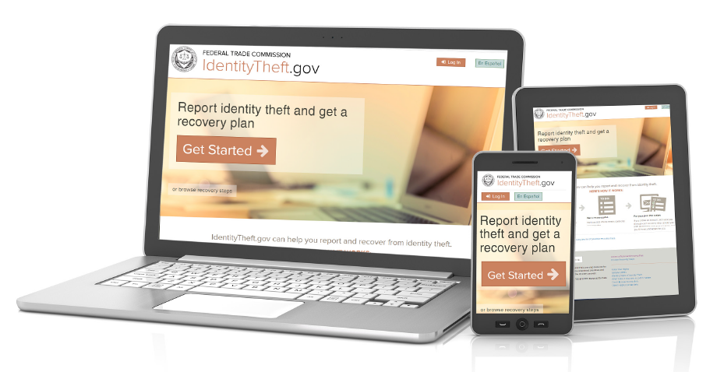
If Inaccurate Information is Due to Identity Theft
Notes:
There’s a different process to follow if you think that inaccurate information on your credit report is due to identity theft. If you see accounts on your report that you never opened or credit inquiries by companies where you never applied for credit, these may be signs of identity theft.
Visit IdentityTheft.gov to report the identity theft and get an FTC Identity Theft Report. IdentityTheft.gov will walk you through the next steps of sending your Identity Theft Report to the credit bureaus and contacting the businesses where the identity theft occurred. You’ll also get a personal recovery plan.
Remember that you can only use Identity Theft Reports for debts that result from identity theft. Filing an Identity Theft Report to block information about debts that you really do owe is against the law.

Slide 10
How To Spot Credit Repair Scams
Scammers say: Credit problems? No problem!
Scammer say: We can remove bankruptcies, judgments, liens, and bad loans from your credit file forever!
Scammers say: We can erase your bad credit, guaranteed!
Notes:
Let’s talk a moment about truthful but negative information on your credit report. Negative information is information about things like late or missed payments, accounts that have been sent to collection agencies, repossessions, and bankruptcies. Most accurate negative information will stay on your credit report for seven years. Bankruptcies will stay on your report for seven to 10 years, depending on the type of bankruptcy.
There are companies that promise they can “fix” your credit. You see the ads all over — in newspapers, on TV and radio, in the mail, and online and in email. You might even get calls offering credit repair services. They all make claims like these (on the slide), promising to quickly remove accurate negative accounts from your credit report.
Do yourself a favor and save some money, too. These claims are signs of a scam. Simply don’t believe them. Companies that promise to repair your credit can’t remove truthful negative information. It takes time to go away. If a company tells you it’ll get rid of any negative information on your report — even if the information is accurate and timely — that company is a scam. Walk away.

Slide 11
Credit Repair Scams – Look For the Red Flags
Scammers insist you pay them before they help you
Scammers tell you not to contact the credit bureaus yourself
Scammers tell you to dispute accurate information on your credit report
Scammers tell you to lie on your credit and loan applications
Learn more at ftc.gov/credit, “Fixing Your Credit FAQs”
Notes:
If you’re considering hiring a credit repair company, look for the red flags of a scam. Don’t do business with a company that:
Insists you pay before it helps you. That’s illegal.
Tells you not to contact the credit bureaus directly.
Disputes information in your credit report that you believe is accurate, or
Tells you to lie on your applications for credit or loans.
Those are all signs of a scam. And remember — anything a credit repair company can do for you legally to dispute information on your credit report that’s incorrect or incomplete, you can do for yourself at little or no cost.
For more information, please check out ftc.gov/credit, “Fixing Your Credit FAQs.

Slide 12
Take Control of Your Credit
Pay bills by the due date
Pay off debt (especially credit card debt)
Avoid taking on new debt
Consider talking with a reputable credit counselor
Be patient!
Notes:
Improving your credit takes time, but you can do it. Your first step is to fix mistakes on your credit report, and that’s what we’ve been focusing on. These steps also will help:
Pay your bills by the due date. You want to avoid late payments because they have a big impact on your credit.
Pay off your debt — especially credit card debt — as quickly as you can.
Avoid taking on new debt if possible.
If you’re in debt and need help, look for a reputable credit counseling organization. You often can find non-profit credit counseling programs offered through credit unions, universities, military personal financial managers, and the U.S.D.A.’s Cooperative Extension Service branches. Unlike credit repair scammers, a good credit counselor will discuss your entire financial situation with you and help you create a plan. They won’t promise to fix all your problems or ask you to pay a lot of money before doing anything.
Fixing your credit takes patience, but you can be confident in knowing that the sooner you begin working to improve your credit, the sooner you’ll see results.

Slide 13
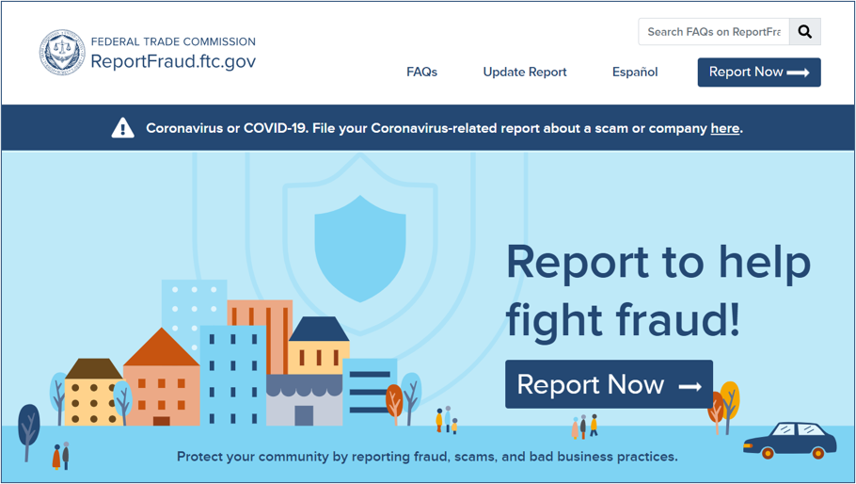
Report Fraud to the FTC
English:
ReportFraud.ftc.gov
Spanish:
ReporteFraude.ftc.gov
Notes:
If you have a problem with a credit repair company, or if you spot a scam, please report it to the FTC at ReportFraud.ftc.gov or ReporteFraude.ftc.gov to report in Spanish.
This is what the site looks like when you report a scam.
The FTC uses reports to investigate and bring law enforcement cases. Reports also help the FTC know what scams to alert people about, so they can protect themselves, their friends, and family.
When you follow a few short steps at ReportFraud.ftc.gov, your report is instantly available to more than 3,000 federal, state, and local law enforcers across the country. And, once you tell the FTC what happened, you’ll get advice on what to do to recover and how to guard against fraud in the future.

Slide 14
Get and Share FREE Resources
Learn about credit: ftc.gov/credit
Learn about scams: consumer.ftc.gov
Keep in touch: ftc.gov/consumeralerts
Get print materials: ftc.gov/bulkorder
Notes:
I mentioned at the start that partners are a powerful way to spread the word. Now that you’re part of our network, we hope you’ll share what you learned with people you know. Here are some other places to learn more about your credit and other consumer protection topics. And an important way to keep in touch.
ftc.gov/credit — has detailed information about getting credit, credit reports and scores, sample letters for disputing errors on your credit report, and much more.
Consumer.ftc.gov — has articles, videos, and graphics about a whole range of consumer protection topics.
ftc.gov/ConsumerAlerts — is the best way to keep up with the latest from the FTC, including the top scams it sees. Sign up to get alerts and keep in touch!
ftc.gov/bulkorder — is where you can order printed materials, for free, in English and Spanish. The FTC will ship them to you for free. We hope you’ll order early and often.
It’s worth repeating that all of the FTC’s consumer resources are also available in Spanish online and in print. I hope you’ll share these resources in your communities. Thanks so much for your time and attention.

Slide 15
Questions
Notes:
Are there any questions?

Slide 16
Thank you
Notes:
Thanks again for your time today.

